Slide 1
Lesson objective
Title: Equations
Aim:
Identify true and false equations
Use the inspection method to solve equations
Plan:
Daily review
Indices practice
Inspecting equations
Need whiteboards

Slide 2

Daily review: exercise books
Evaluate
$$3^{3}=$$
$$2^{4}=$$
$$5^{3}=$$
Evaluate
11 + (-9) =
13 – (-4) =
-8 – (-20) =

Slide 3
Practice
FINISH task sheet NA 17 Index notation. Both sides.

Slide 4
The word is
Equation
- A mathematical statement that two things are equal.

Slide 5
Which of these is an equation?
2 + 8 = 10
9 – x = 6
4a
4a + 7y
10x – 2y = 20
We DO NOT need to know the value of these pronumerals. An equation states that what is on one side of the equal side is the same as the other side.

Slide 6

LHS and RHS
There are 2 sides in an equation:
$$4x+3=11$$
If the LHS = RHS it is a TRUE equation.
If they DO NOT equal, it is a FALSE equation.
Left Hand Side
Right Hand Side

Slide 7

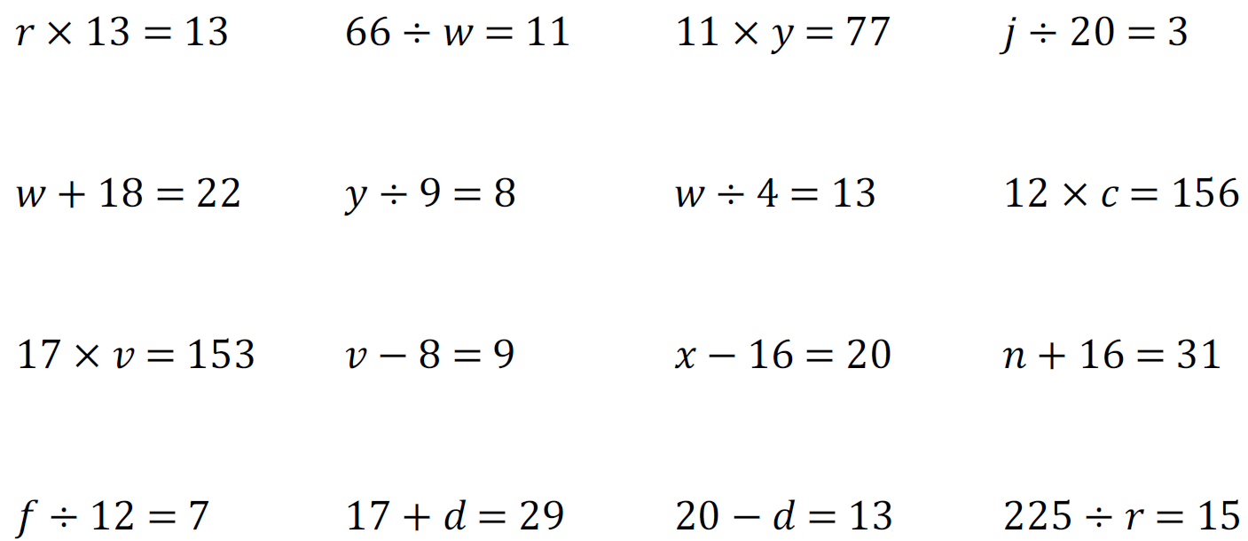
Solving Equations by Inspection
Solving equations means ‘finding the unknown value’
The unknown value is called the solution
Doing this just by looking is called inspection
We check our answers by rewriting the equation
5 + __ = 8
12 – f = 9
5y = 15
10 ÷ 2 = x

Slide 8
Whiteboards
Try solving these equations:
3 + x = 7
a + 11 = 15
20 ÷ t = 5
10 – a = 3
4f = 12

Slide 9
Individual practice
Page 411
(Bottom of the page) Questions 1 ➔ 10

Slide 10
Fist to five
Aim:
Identify true and false equations
Use the inspection method to solve equations

